Slide 1
Grip-specific neural population dynamics are not shared between action and observation in the frontoparietal cortical grasping network
James Goodman¹
Stefan Schaffelhofer^{1,2}
Hansjörg Scherberger^{1,3}
¹Deutsches Primatenzentrum GmbH, Göttingen, Germany
²Current affiliation: cortEXplore, Linz, Austria
³Department of Biology, University of Göttingen, Germany
21 April 2021
Notes:
Thank you. Today, I will be talking about our work to understand the link between movement execution and observation in the cortical grasping circuit.
===
REMEMBER TO MOVE THE LASER POINTER OFF SCREEN WHEN YOU ARE NOT USING IT

Slide 2
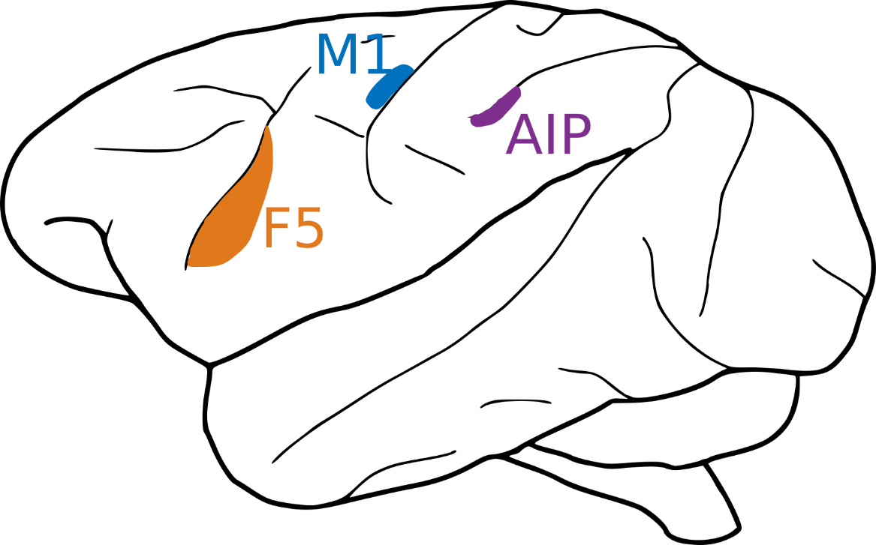
The frontoparietal grasping network is highly interconnected and mediates grasping behavior
Primary motor cortex (M1)
Rostral ventral premotor cortex (F5)
Anterior intraparietal area (AIP)
Notes:
We are interested in the cortical control of grasping, for which the frontoparietal grasping network is especially important. This comprises the anterior intraparietal area (AIP), the rostral division of the ventral premotor cortex (F5), and the primary motor cortex (M1).

Slide 3
The frontoparietal grasping network is highly interconnected and mediates grasping behavior
Primary motor cortex (M1)
Rostral ventral premotor cortex (F5)
Anterior intraparietal area (AIP)
Notes:
These areas exhibit hierarchical connectivity (AIP to F5 to M1), which parallels the transition of information from relatively visual in AIP to movement-preferring in M1.

Slide 4
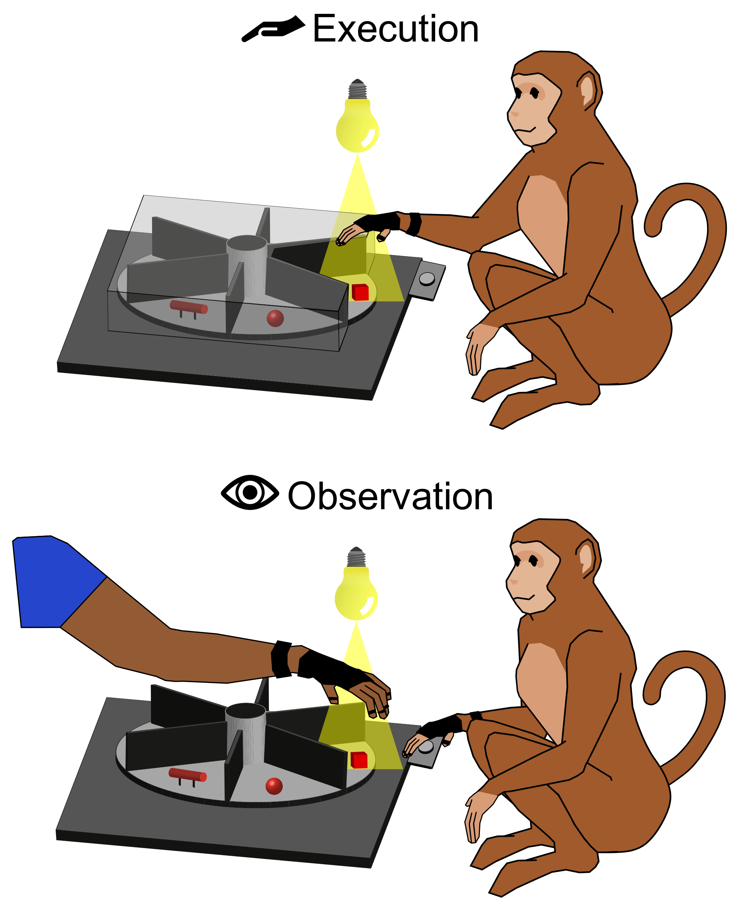
Grasp execution
Notes:
In addition to responding during execution of grasping movements,

Slide 5
Grasp execution and observation
Notes:
Neurons in these areas also respond during the mere observation of others performing grasping movements. The nature of these latter responses remains hotly debated. So, we aim to study them using a paradigm with:
a whole lot of objects presented via turntables,
monkeys trained to grasp these objects and to observe humans doing so,
floating microelectrode arrays simultaneously recording neuronal populations in AIP, F5, and M1

Slide 6
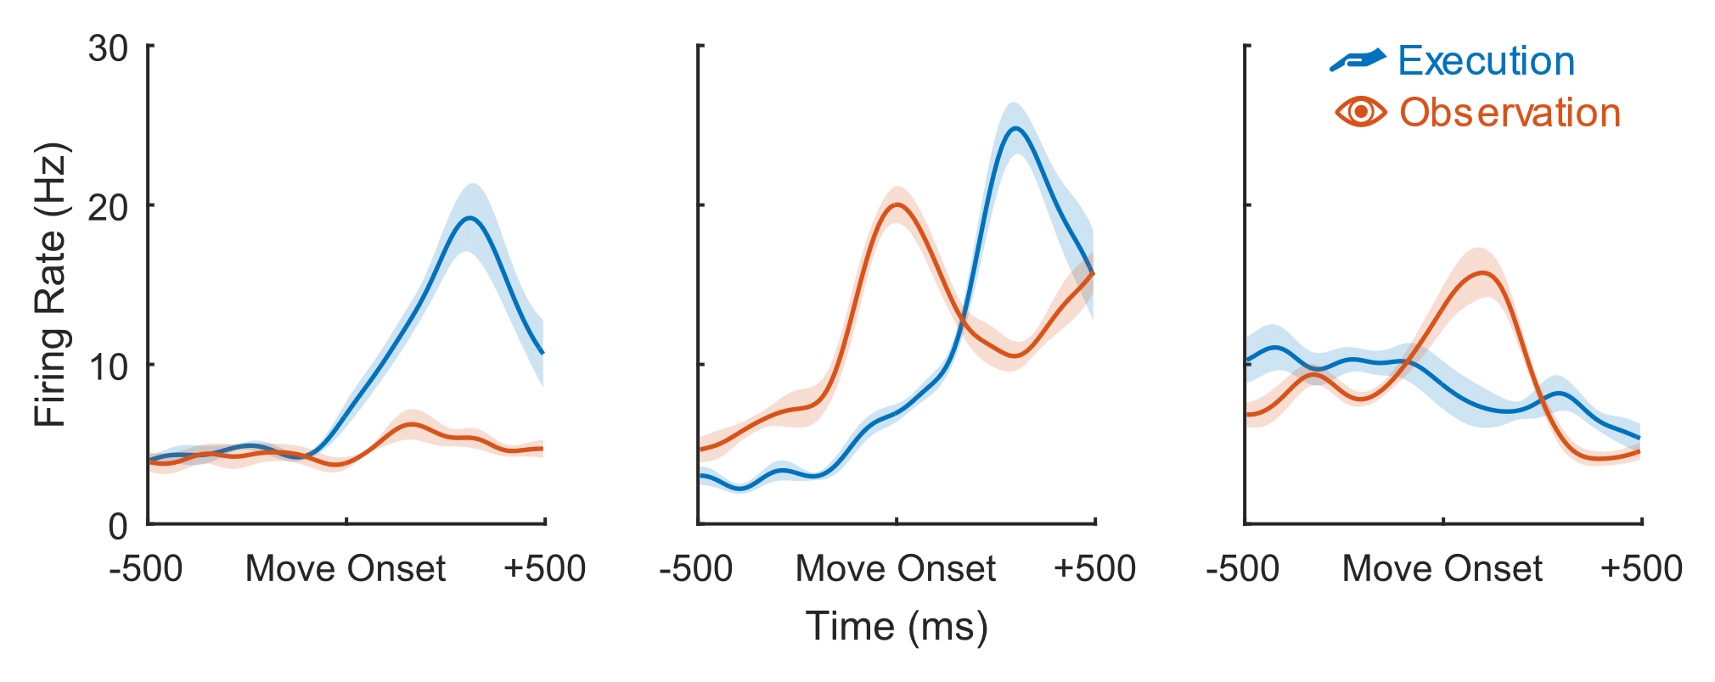
There is a broad spectrum of relative preference for observation and execution throughout each population
Notes:
Responses in F5 and AIP span a continuum of preferences for observation and execution. Shown are trial-averaged firing rates of three neurons to show different points along this continuum.
Some neurons, like those on the left, appear to be "strictly motor" units.
Others, like those on the right, actually exhibit a preference for observed grasps.
And others, in the middle, might be called “mirror neurons”.
However, we ran the statistics and find no evidence for distinct clusters of mirror and nonmirror neurons.
===
(Moe 46, F5: 25th, 85th, and 99th percentile neurons)
(This corresponds to what the 25th, 50th, and 75th percentile neurons, respectively, look like in AIP)

Slide 7
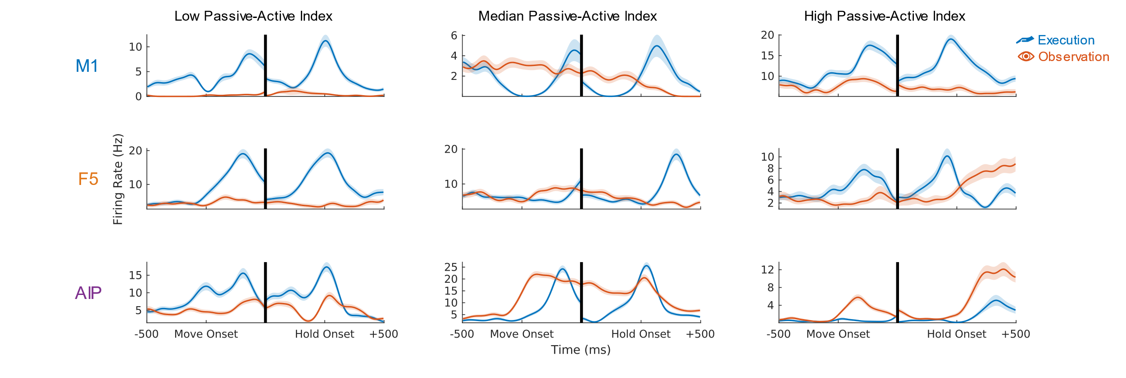
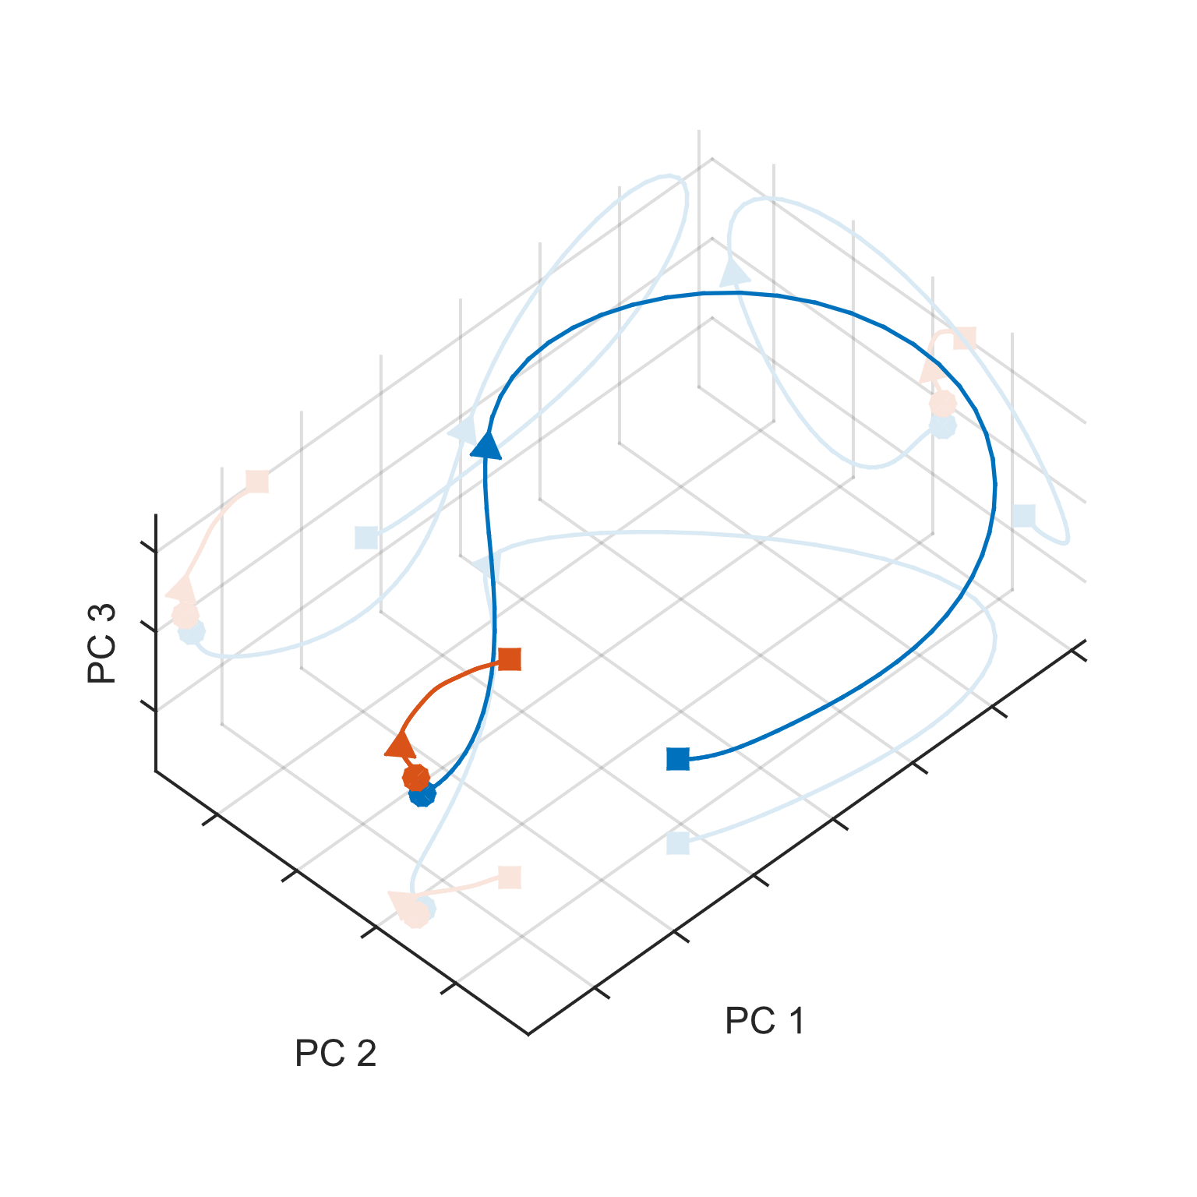
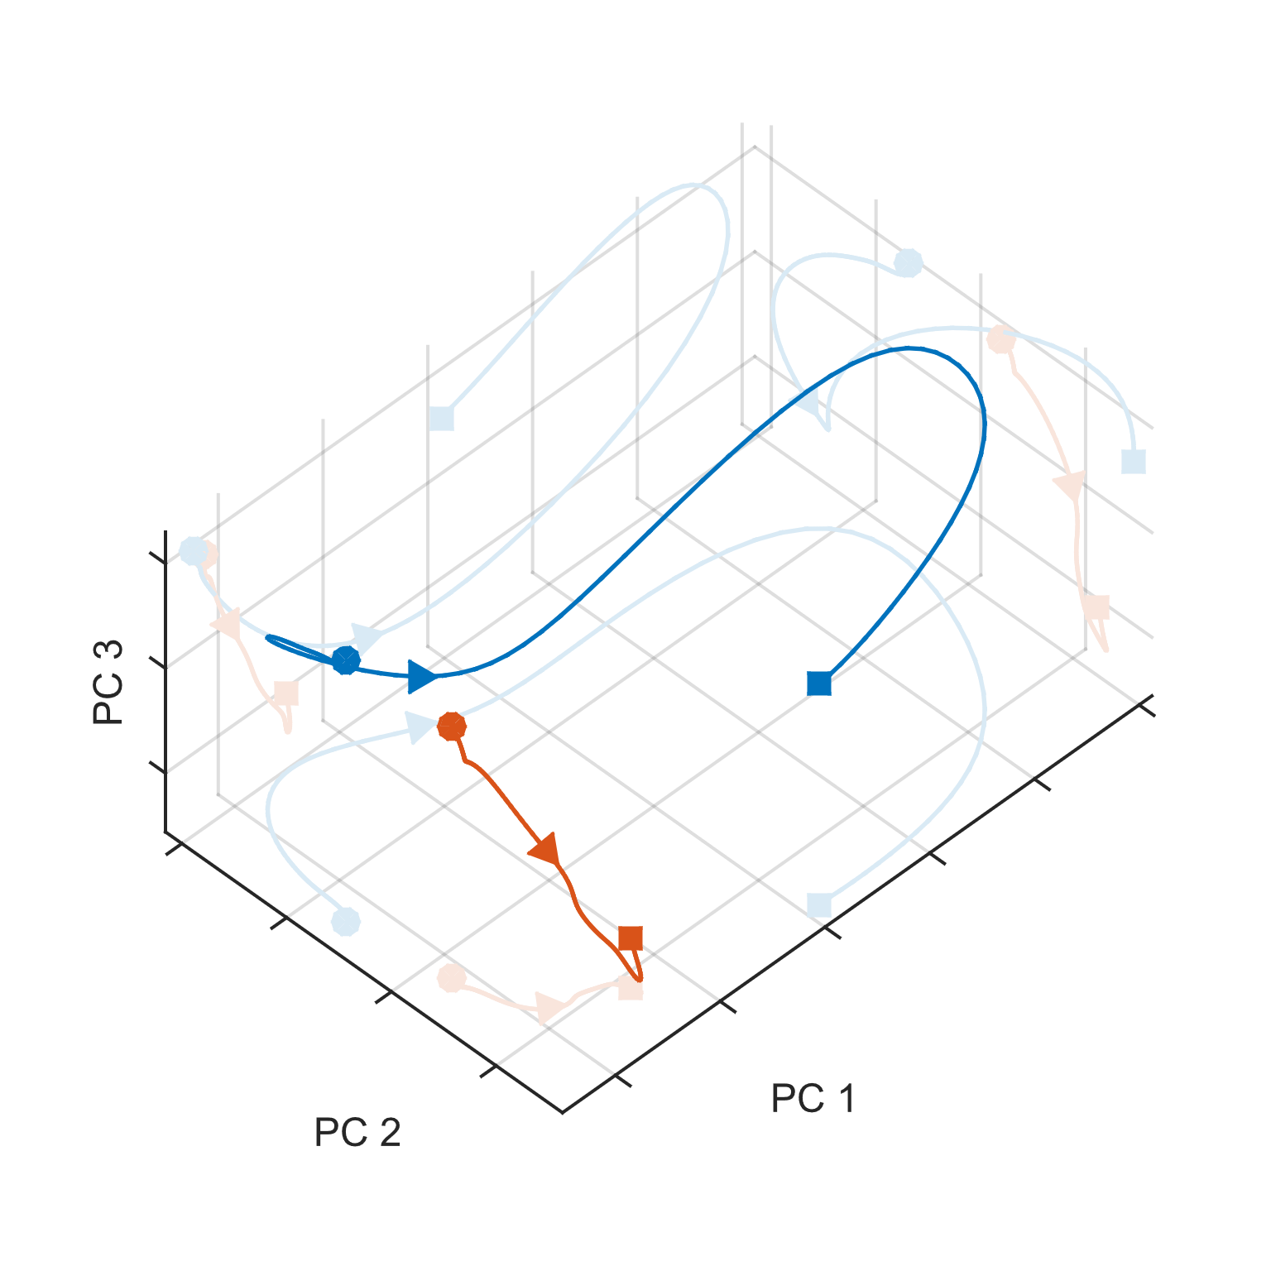
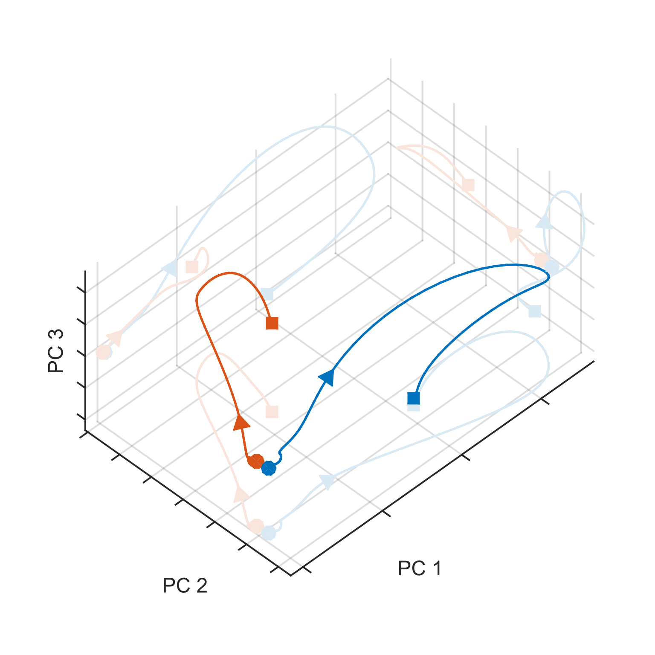
State-space analysis reveals generally non-overlapping patterns of activity
M1
F5
AIP
-500ms
0 ms
+500 ms
from Move Onset
Notes:
So, we turn to neuronal state space to understand what is happening in these populations. As an example of this, one could consider the firing rates of a population of 3 neurons as trajectories in a 3-dimensional space. We do something similar here, using Principal Component Analysis (PCA) to visualize the activity of many more than 3 neurons. In each area, execution- and observation-related trajectories are not strictly overlapping.
===
Moe 50

Slide 8
A common subspace captures patterns of activity actually shared between execution and observation
M1
F5
AIP
-500ms
0 ms
+500 ms
from Move Onset
Notes:
However, we can find a common subspace where these trajectories do, indeed, overlap. We do this by finding a subspace within which we maximize the fraction of observation variance explained by a one-to-one match with execution activity. Shown here are the same data from before, projected onto a 3D common subspace.

Slide 9
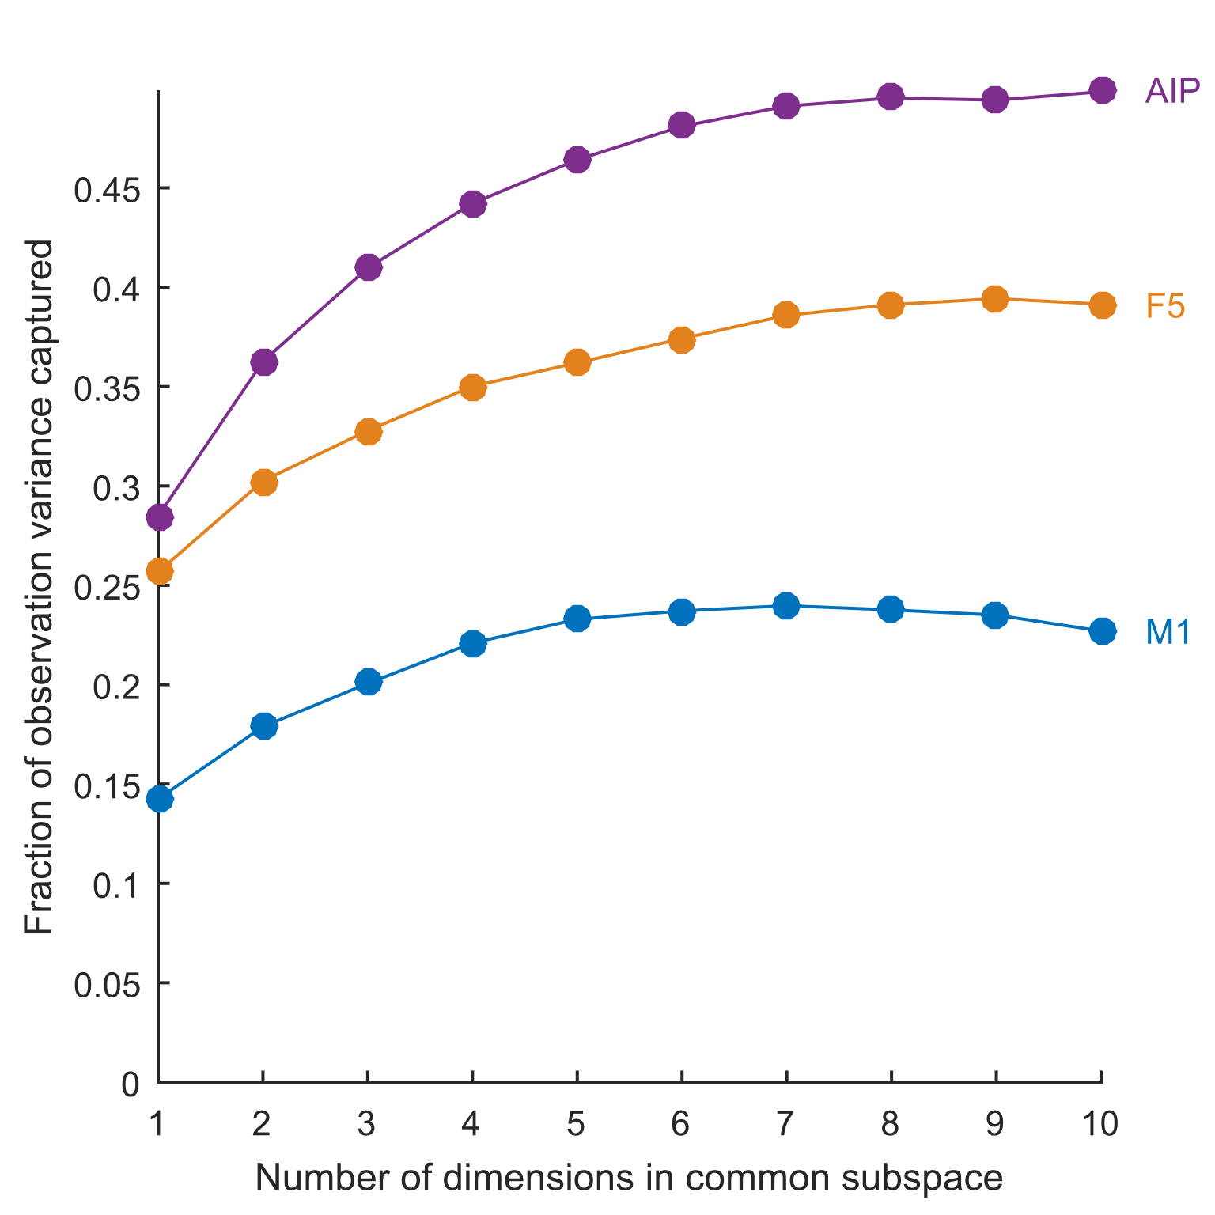
The common subspace explains less variance from AIP to F5 to M1
Notes:
If we apply this method for various dimensionalities of common subspace, we find this common subspace consistently captures substantial variance, but less and less as one progresses from AIP to F5 to M1.
===
In other words, there doesn’t seem to be any magical, super secret shared subspace in any of these areas, at least beyond the first component where variance captured is particularly high.
===
Note, by the way, that F5 remains intermediate by this measure and by all others so far. The posterior parietal area AIP, which is more visually responsive yet is rarely directly implicated in any mirror-like mechanisms, nonetheless seems to exhibit the greatest overlap between execution and observation conditions.

Slide 10

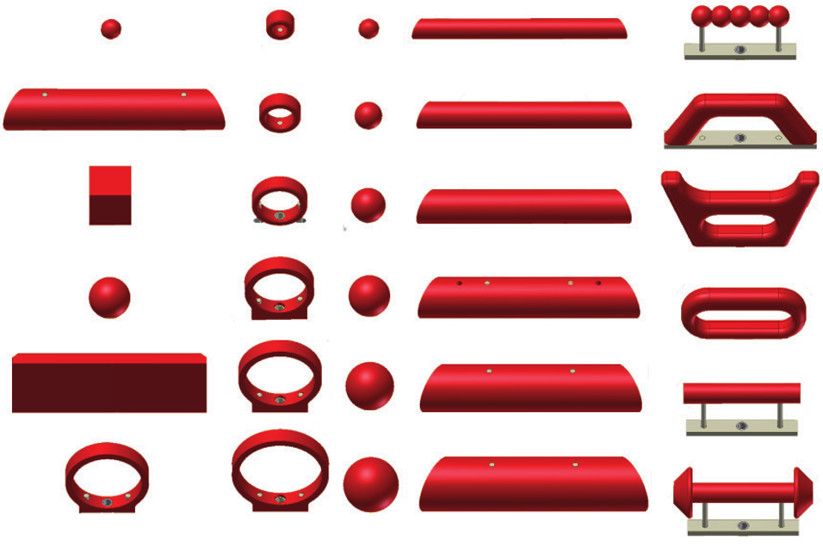
Grip representations should form distinct clusters in neuronal state space
Exe
Notes:
From here, we ask how detailed this common activity is. We know that, during execution, the endpoints of neuronal trajectories should form grip-specific clusters in neuronal state space, such as those shown in this cartoon.

Slide 11

Grip representations during execution and observation should overlap
Exe
Obs
Notes:
We might, then, expect to see grip-resolved similarities between execution and observation, as shown by the common clustering of filled and open circles in this cartoon.

Slide 12
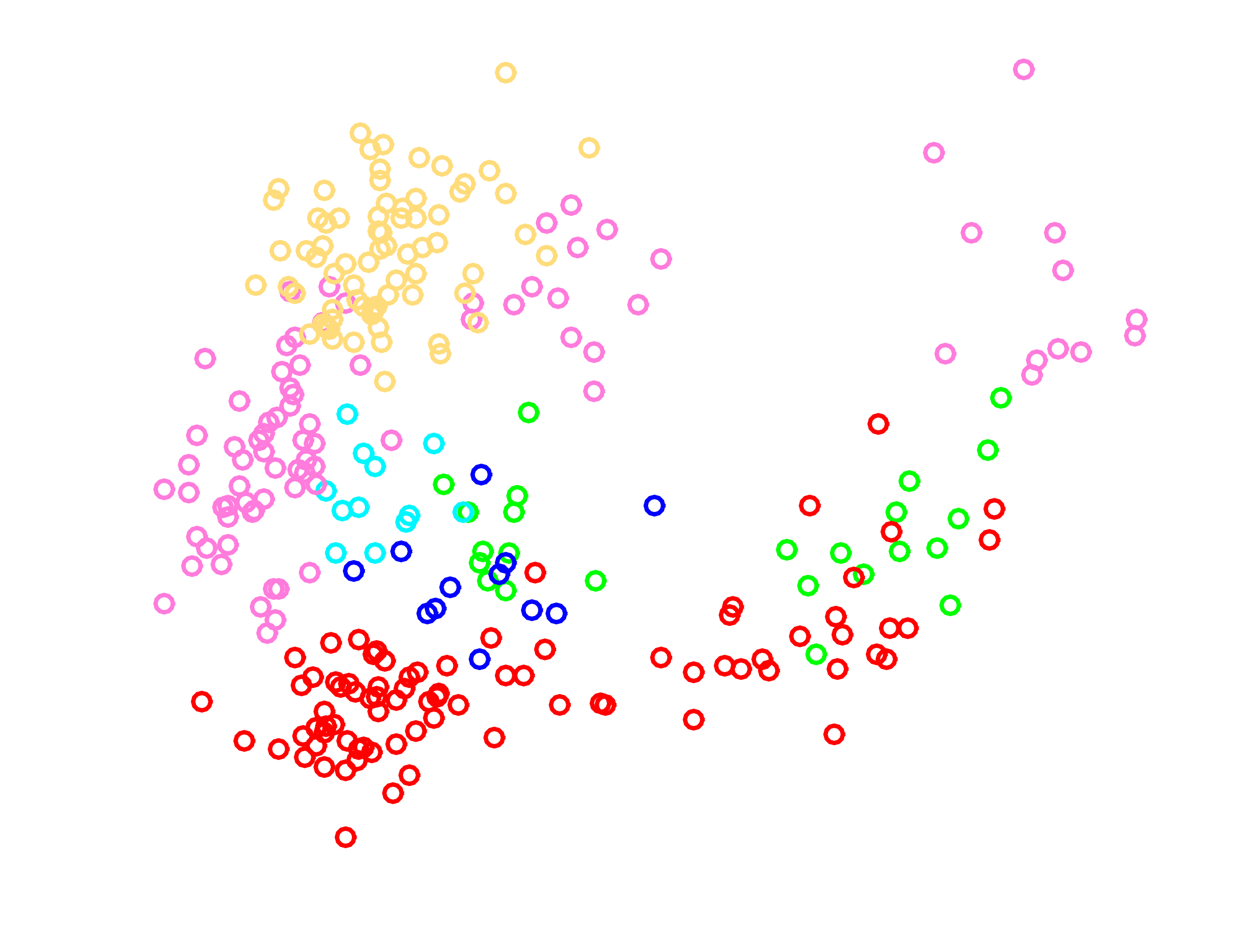

Grip representations form clusters during execution
Ball
Bar
Cube
Cylinder
Ring
Special
Exe
Notes:
When we plot state space projections from F5, we see clusters during execution.
===
(F5, Moe 50)
ball - green
bar - blue
cube - red
cylinder H - teal
ring - magenta
special - yellow

Slide 13
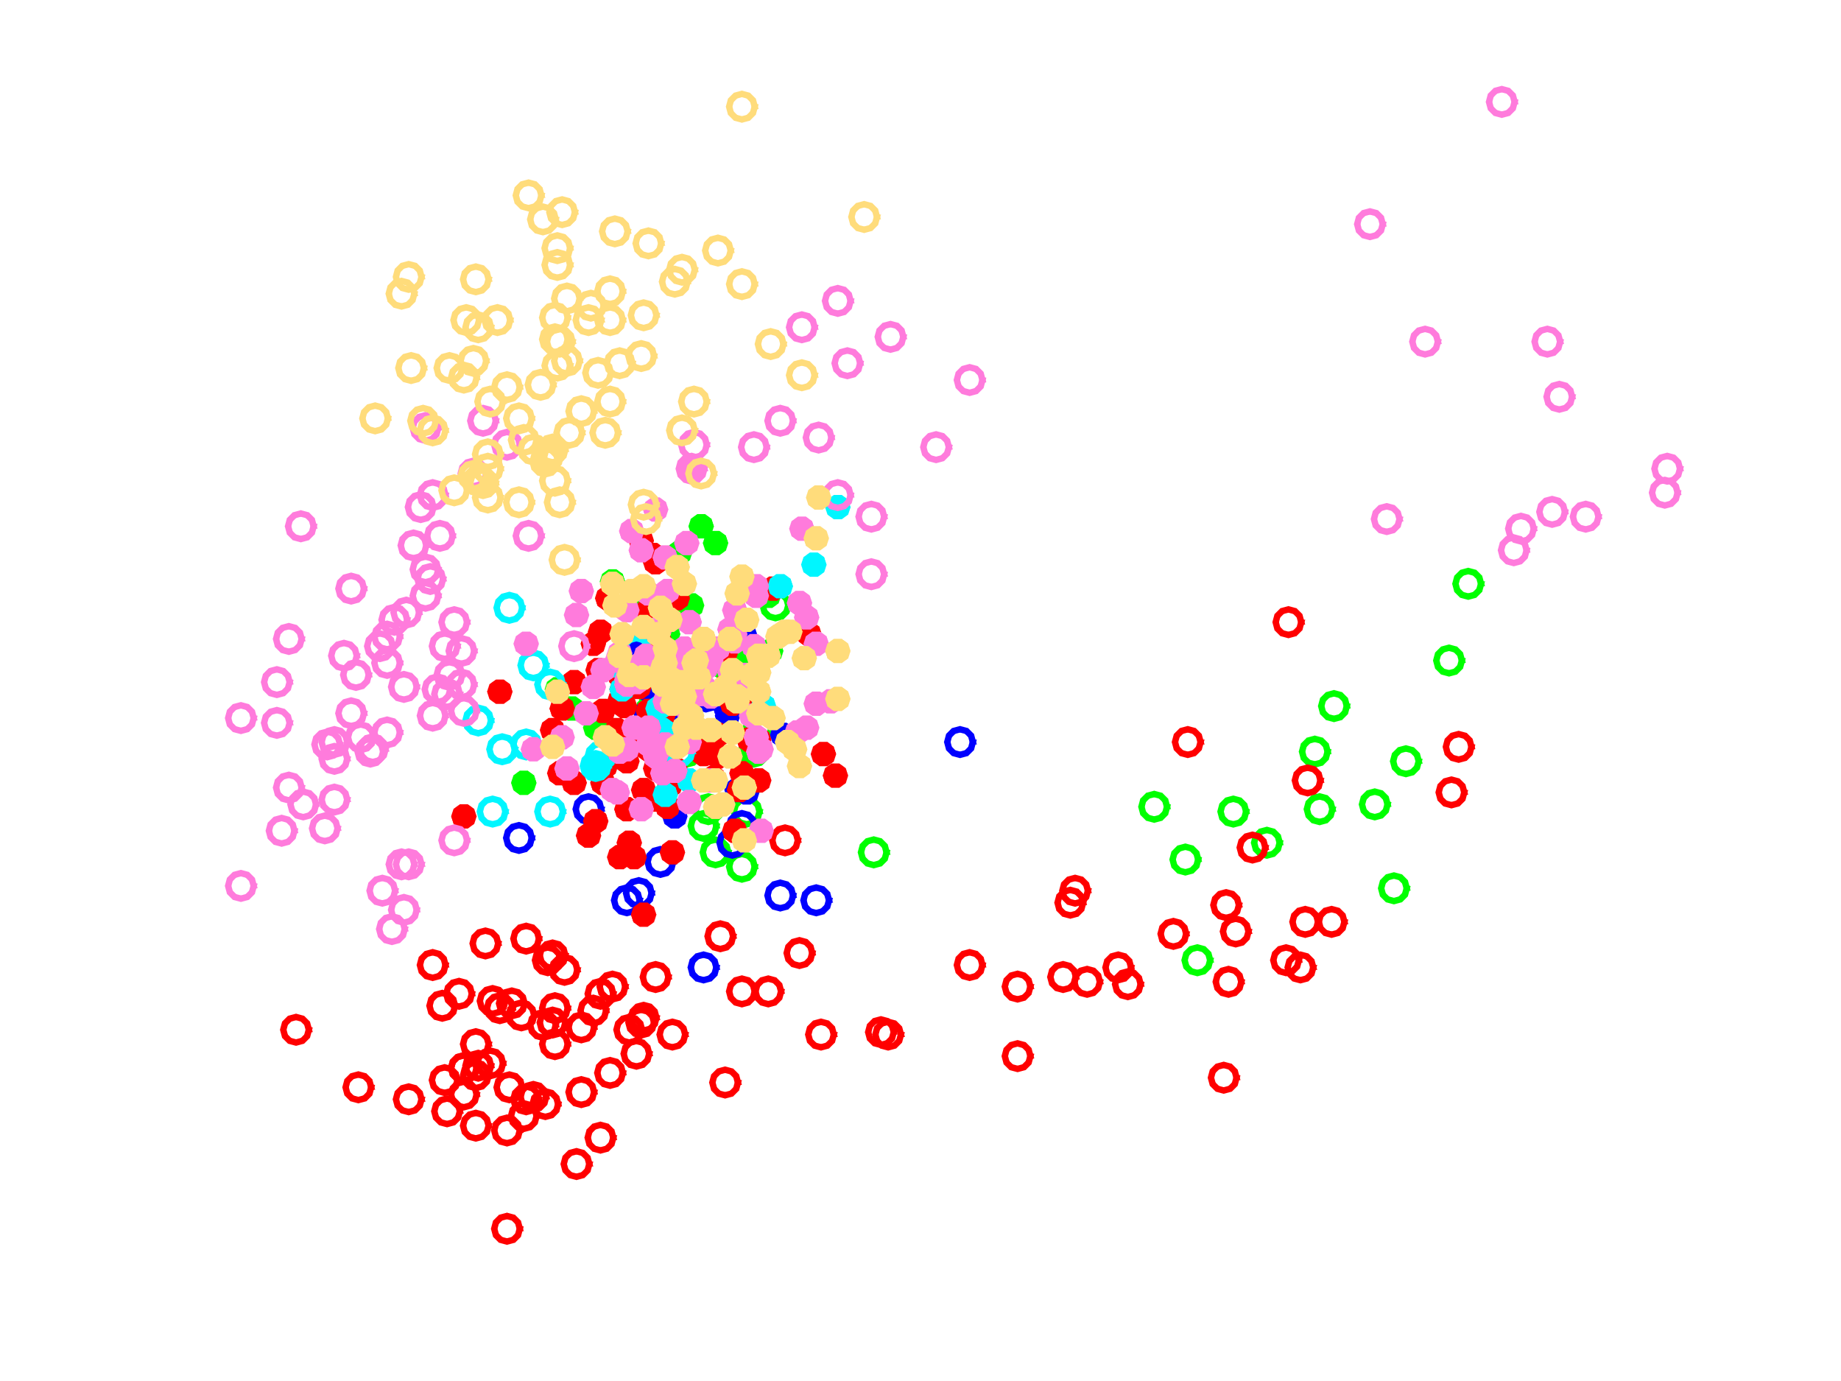
Shared grip clusters do not emerge in a low-dimensional space
Ball
Bar
Cube
Cylinder
Ring
Special
Exe
Obs
Notes:
However, when we combine observation activity, things look much messier instead of matching this pattern of clustering. Nonetheless, this is only in two dimensions.

Slide 14
Cross-classification reveals no shared grip clusters even in a higher-dimensional space
AIP
Classification Accuracy
Notes:
We use a classification analysis to assess clustering in a much higher-dimensional neuronal state space. This is a cross-classification analysis, in which we trained on one task (rows) and tested on another (columns). Shown is a heatmap of classification accuracies in AIP for each cross-training pair. We can find substantial grip clustering during execution, which is much weaker during observation, and this also translates to poor clustering when training across tasks. In M1 and F5, this pattern is only amplified.
===
We performed this analysis after orthogonalizing with respect to visual and preparatory object representations, as this information was not temporally segregated from movement-related activity (but did prove to be nicely orthogonalizable) and thus otherwise contaminated our classifiers.
===
There appears to be some small amount of overlap in AIP when testing on execution after training on observation, and it is significantly above chance and we are interested in pursuing this, but by and large the cross-classification performance is quite poor.
===
Yes, we've tried SVM-based methods. They're actually even worse.
===
Moe 50 AIP

Slide 15
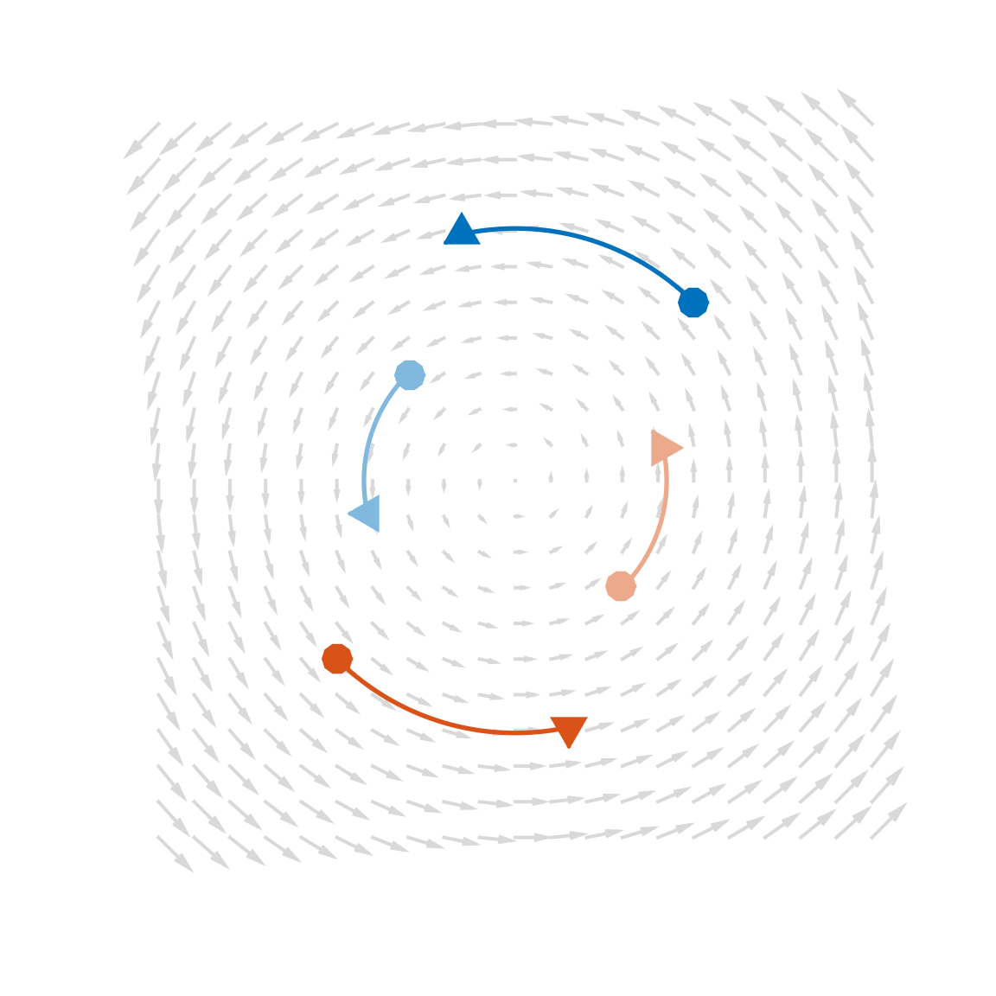
In development: state space dynamics may yet reveal shared grip-specific structure
Grip 1
Grip 2
Component 2
Component 1
Notes:
From here, we are seeking other ways to assess the link between execution and observation. For instance, an alternative perspective – namely, the framework of dynamical systems – could, in some cases, capture common structure that fails to give rise to consistent clustering of responses. Our methods are, however, still in development.

Slide 16
Summary of results
There is no clustering of neurons into clear mirror and nonmirror populations
There are shared activity patterns between execution and observation
Shared activity is most prevalent in AIP, least in M1
These shared activity patterns do not seem to capture grip-specific information
Notes:
In summary:
We observe no clustering of neurons into clear mirror and nonmirror populations.
There are, however, shared activity patterns between execution and observation.
This shared activity is most prevalent in AIP, least in M1, with F5 following this trend
These shared activity patterns do not seem to capture grip-specific information
We are considering alternative ways that execution and observation may yet be linked.
Thanks for your time.

Slide 17
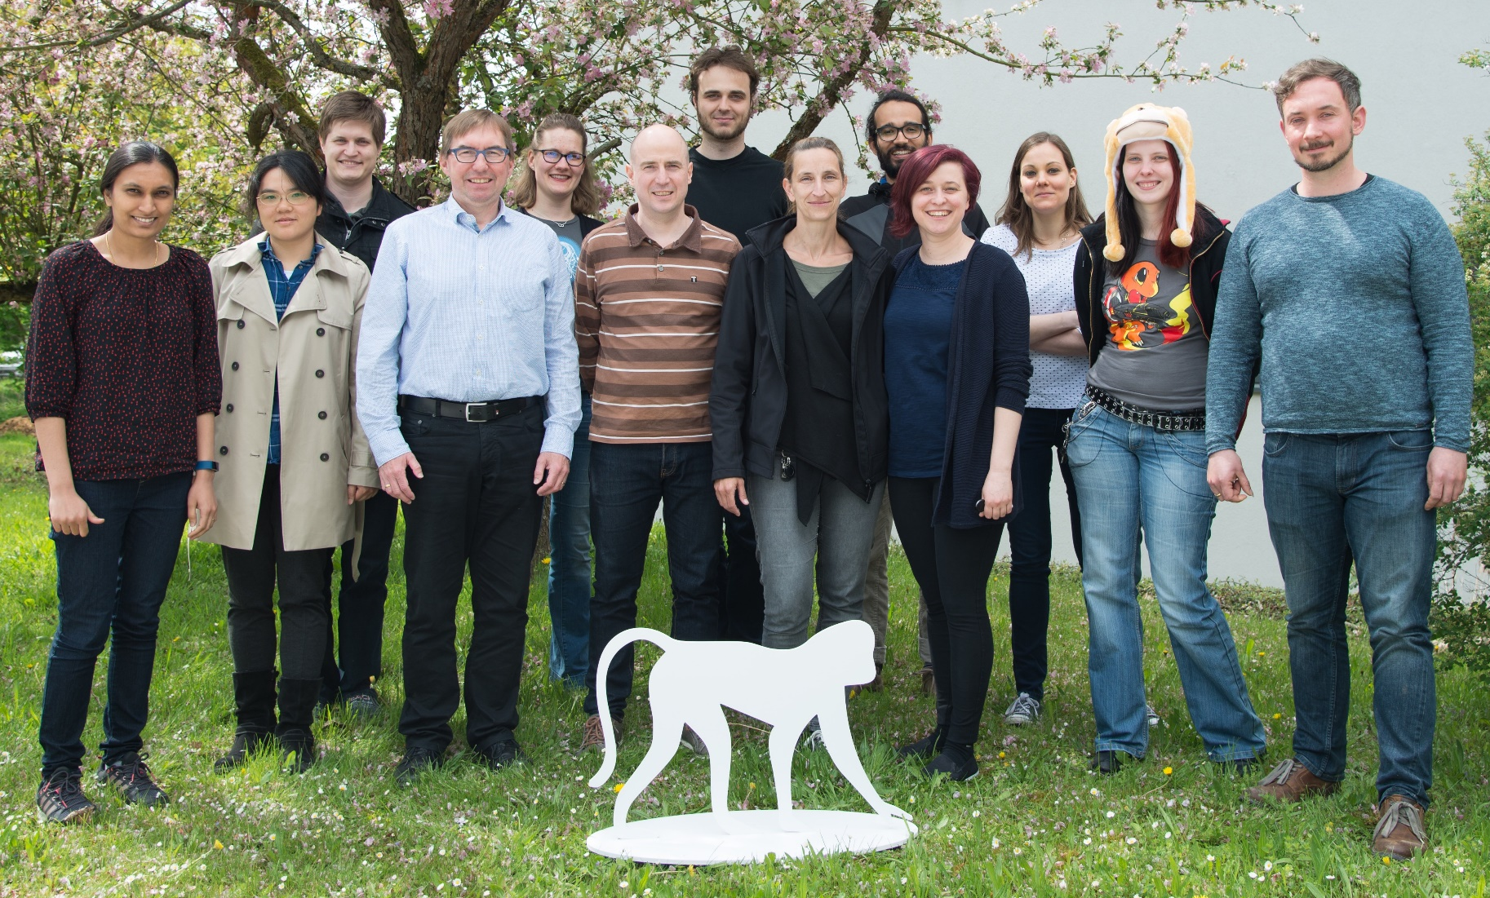




Thank you!
Co-funded by the European Union
Neurobiology Laboratory ca. 2018

Slide 18
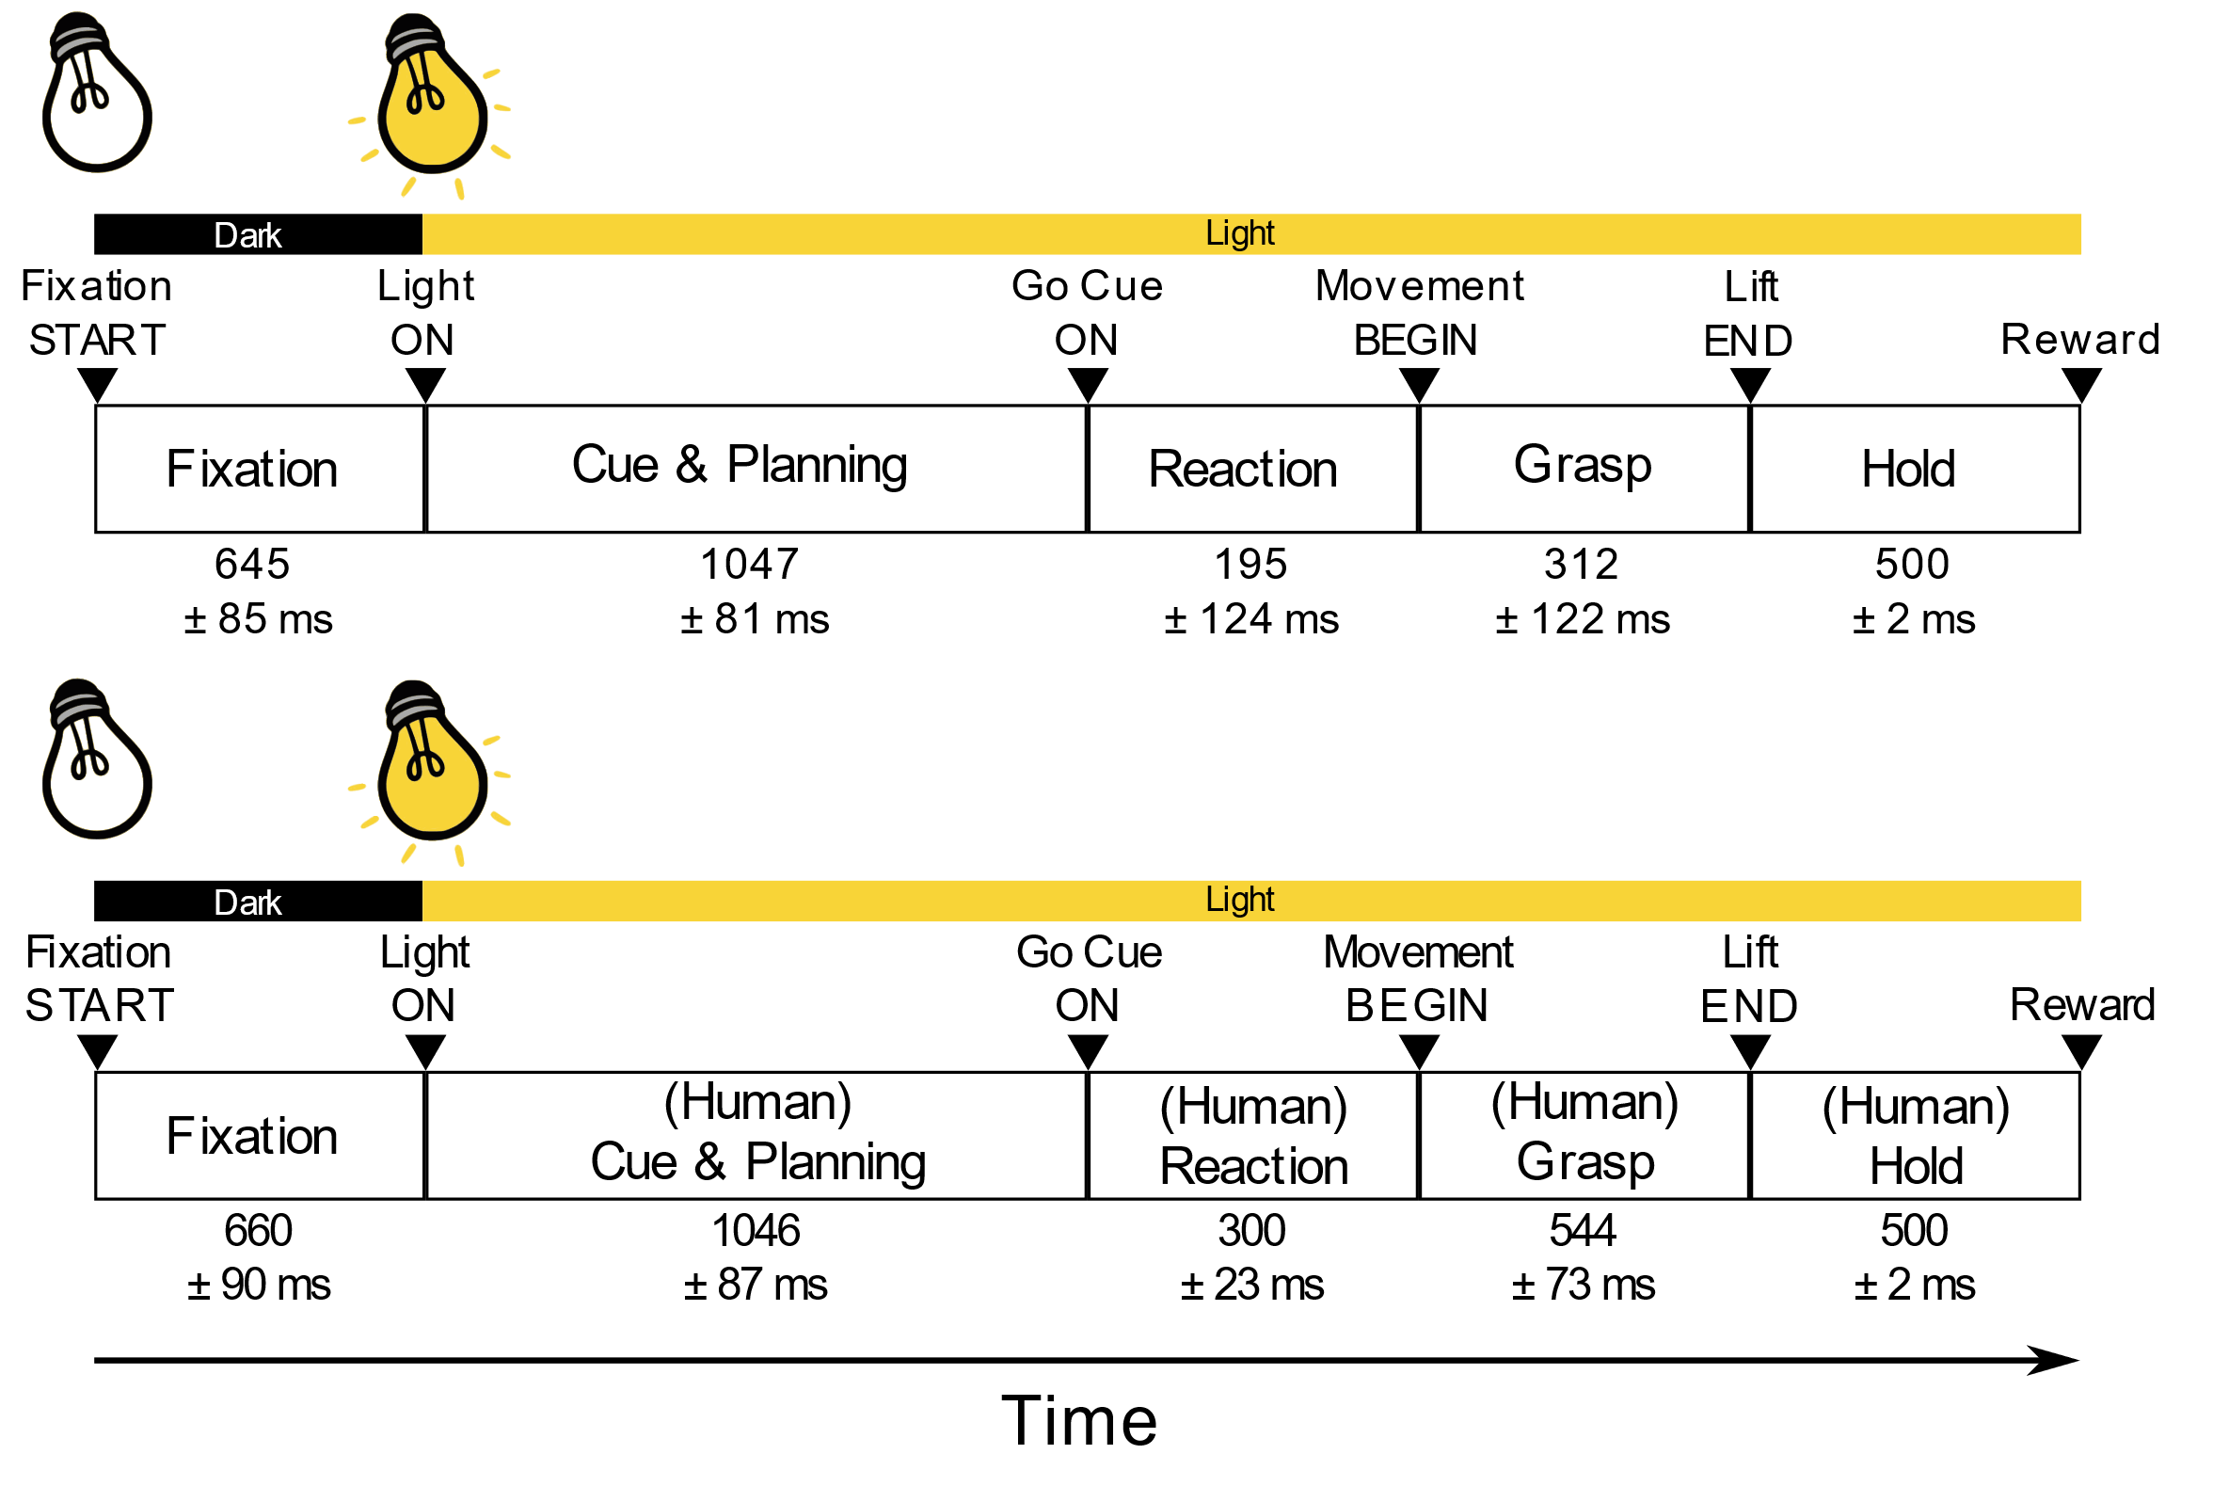
Task Timing

Slide 19
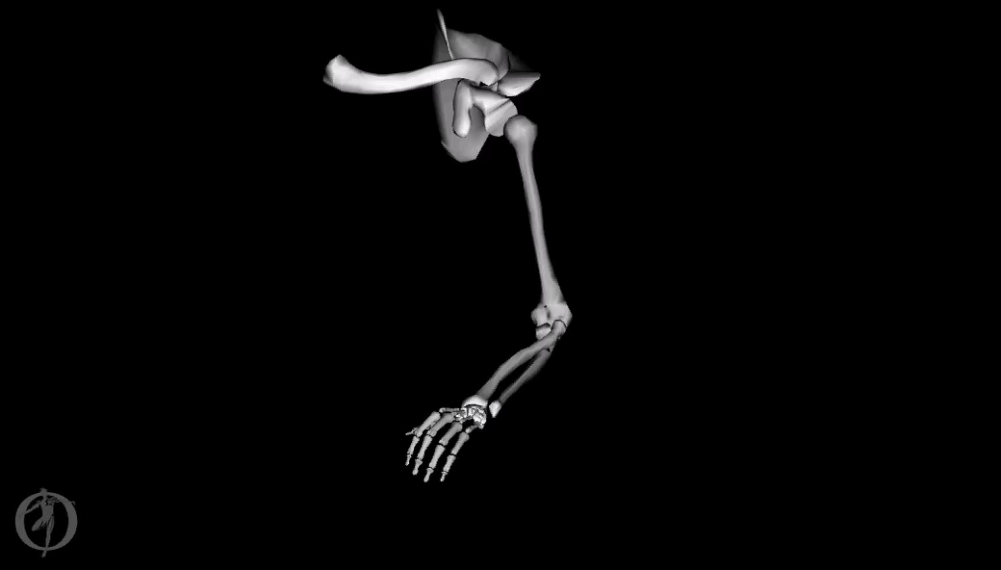

Animal does not move during Observation Task
Observation
Execution
Notes:
populate this slide with the kinematic control that you’ve already run (maybe a movie? to show lack of movement during the obs task?)
(EMG control forthcoming!!! ...but not ready just yet...)

Slide 20
Objects give rise to numerous grip types
Object classification on the basis of kinematics
For both monkey & man
PUT THEM HERE
(did this in previous pub)
Notes:
populate this slide with the kinematic control that you’ve already run (maybe a movie? to show lack of movement during the obs task?)
(EMG control forthcoming!!! ...but not ready just yet...)

Slide 21
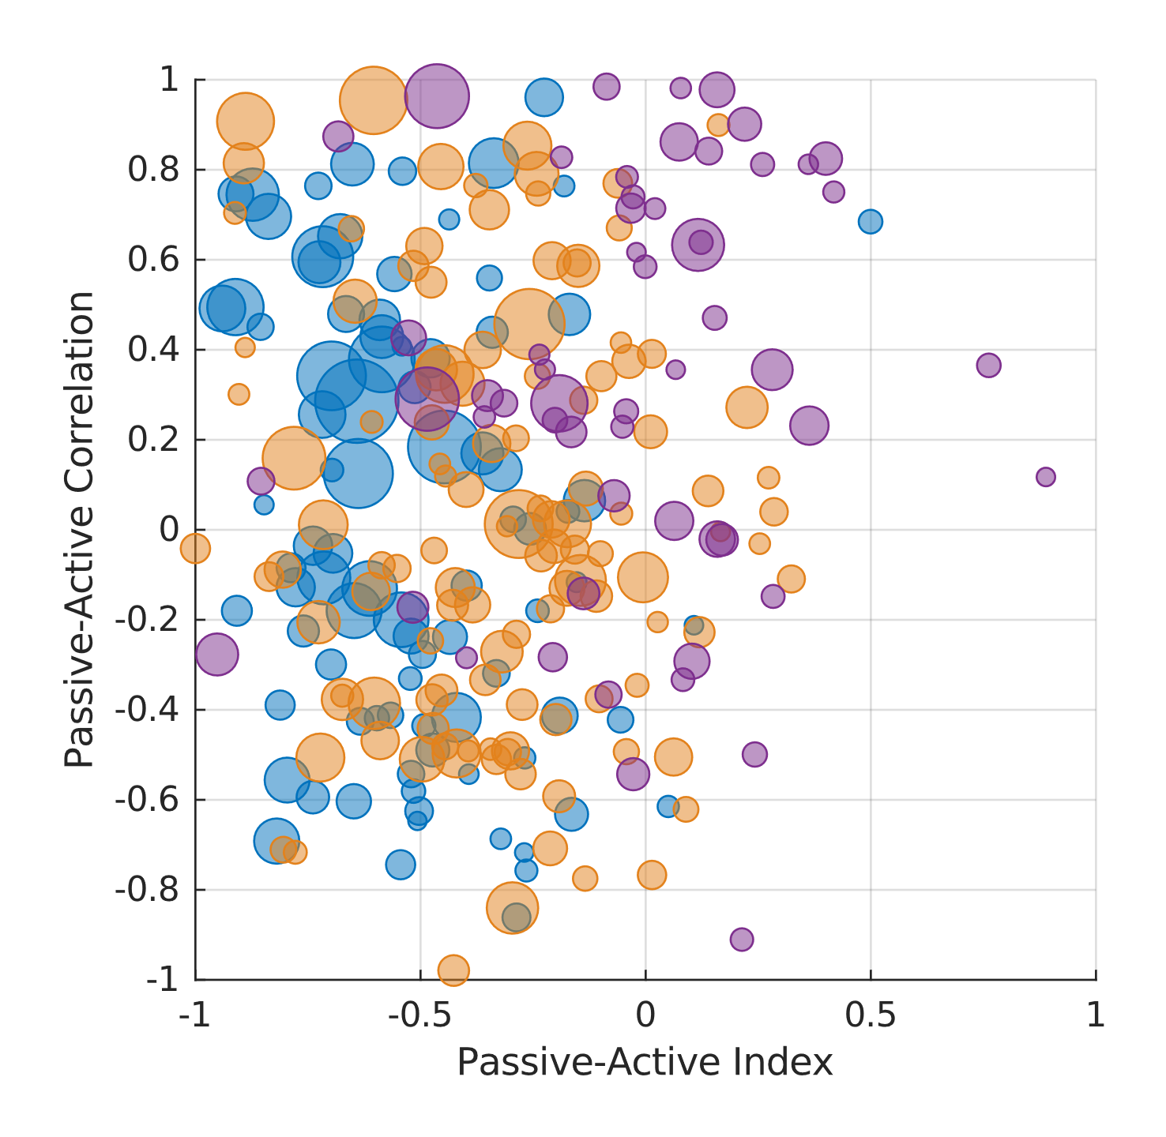
There are no functional cell type clusters
M1
F5
AIP
Notes:
Be sure to KNOW the stats for this plot
The CDF plots would also be nice as supplements, but realistically you simply DO NOT have time to go through them at this juncture
For the eventual paper? Yes.
For this 5 minute talk? NO.

Slide 22
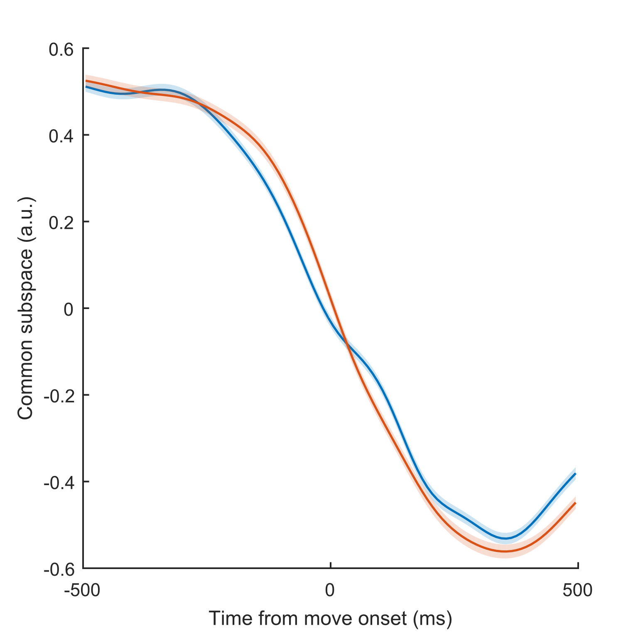
1D shared subspace
Notes:
From here, we can start to look for a common subspace in which execution and observation activity overlap. I’ll once more forego the analytical details, but the result is what we see here in AIP, where each panel corresponds to the trial-averaged projection of neuronal activity onto such a common subspace for a distinct object.
(add a scatterplot of object-specific info too) (and condense these time-varying 1-D plots to a single trace for each task condition – let the scatter plot show object-specific variance, and let the time-varying plot show the dynamics of the common component!)
(contrast against PCA scatterplots of exe & obs in isolation)
(F5 in Moe46)

Slide 23
No distinct cluster of "mirror" neurons
Session | Hartigan p | PAIRS p
Notes:
Table for your stats
PAIRS statistic
and associated p values

Slide 24
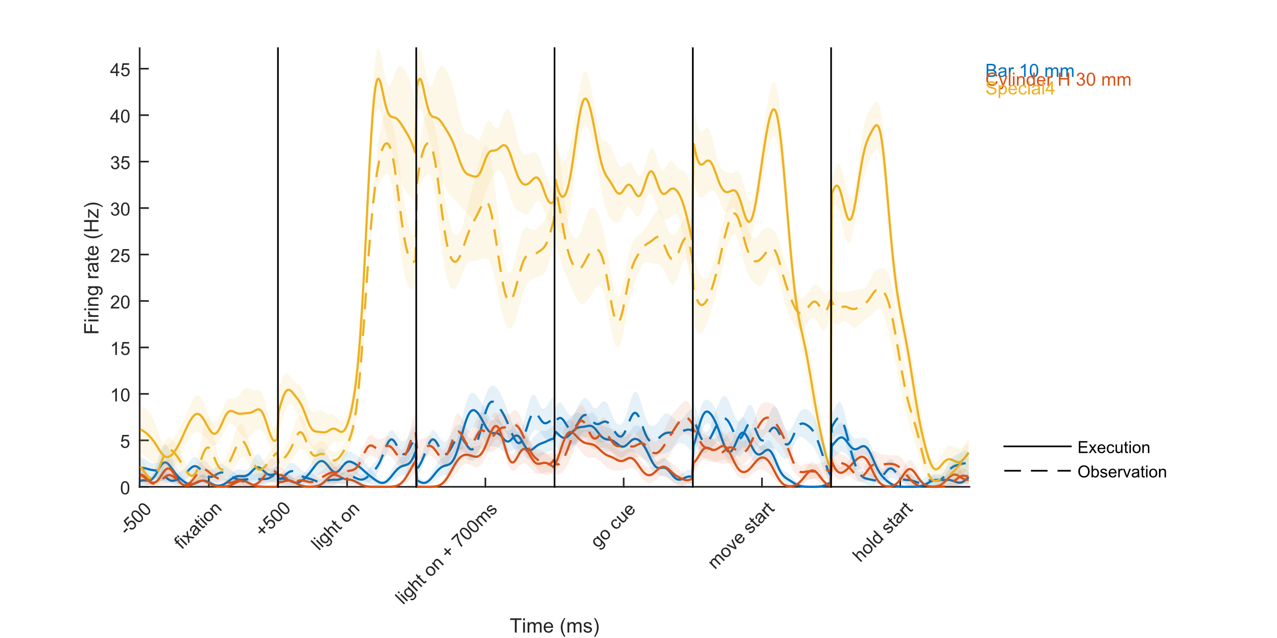
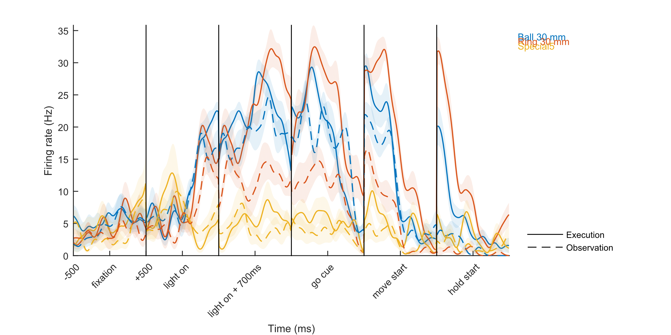
Movement and visual-preparatory signals inconveniently overlap in time
Three
Different
Objects
Notes:
2 (fix these, make em look less shitty, left one is AIP #3, right one is F5 #3, both from Moe50)
Show the PETHs that show this off (these plots are pretty much done!) (gotta run them again tho... and actually SAVE them!!!) (need to run these LOCALLY because saving them on server actually runs into a weird error where it doesn’t actually plot the dashed lines???)

Slide 25
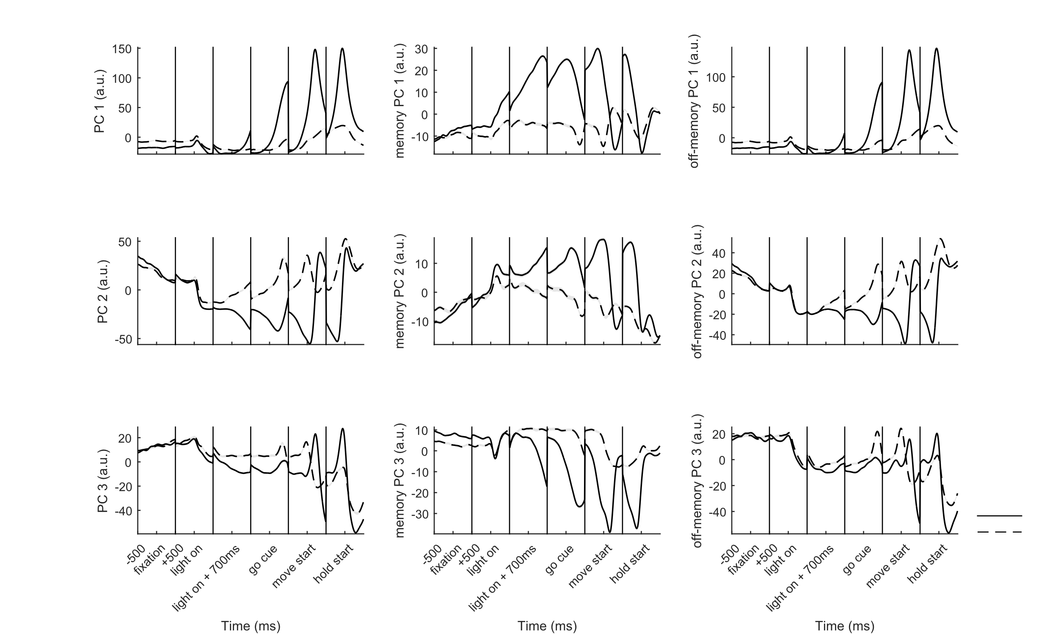
Movement and visual-preparatory activity can be orthogonalized
Exe
Obs
Notes:
3 (F5 of Moe50)
Show the results of this orthogonalization (these plots are pretty much done!) (once again tho: actually SAVE them!!!)

Slide 26
Movement and visual-preparatory activity can be orthogonalized
Exe
Obs
Notes:
3 (F5 of Moe50)
Show the results of this orthogonalization (these plots are pretty much done!) (once again tho: actually SAVE them!!!)

Slide 27
VGG vs MGG, classification
Notes:
6.5 (placeholder)
Basically, show that there's an instance where this analysis actually works
(I mean, this'd be nice for a PAPER, BUT 1) you already did this albeit more incomprehensibly, and 2) you really do NOT have time within your talk! make this a supplement!)
Replace this with your old geode plot tho

Slide 28
VGG vs MGG, classification
Notes:
6.5 (placeholder)
Basically, show that there's an instance where this analysis actually works
(I mean, this'd be nice for a PAPER, BUT 1) you already did this albeit more incomprehensibly, and 2) you really do NOT have time within your talk! make this a supplement!)
Replace this with your old geode plot tho

Slide 29
VGG vs MGG, classification
Notes:
6.5 (placeholder)
Basically, show that there's an instance where this analysis actually works
(I mean, this'd be nice for a PAPER, BUT 1) you already did this albeit more incomprehensibly, and 2) you really do NOT have time within your talk! make this a supplement!)
Replace this with your old geode plot tho

Slide 30
VGG vs MGG, classification
Notes:
6.5 (placeholder)
Basically, show that there's an instance where this analysis actually works
(I mean, this'd be nice for a PAPER, BUT 1) you already did this albeit more incomprehensibly, and 2) you really do NOT have time within your talk! make this a supplement!)
Replace this with your old geode plot tho

Slide 31
VGG vs MGG, dynamics
Notes:
10.5 (placeholder)
Basically, show that there's an instance where this analysis actually works

Slide 32
VGG vs MGG, dynamics
Notes:
10.5 (placeholder)
Basically, show that there's an instance where this analysis actually works

Slide 33
VGG vs MGG, dynamics
Notes:
10.5 (placeholder)
Basically, show that there's an instance where this analysis actually works

Slide 34
VGG vs MGG, dynamics
Notes:
10.5 (placeholder)
Basically, show that there's an instance where this analysis actually works

Slide 35
Classification matrices – M1
M1
Classification Accuracy

Slide 36
Classification matrices – F5
F5
Classification Accuracy

Slide 37
Classification matrices – AIP
AIP
Classification Accuracy

Slide 38
Object clustering in shared subspace
Notes:
plot shown in presentation is in execution-space
which is a little misleading
but ultimately, this fricassee plot tells the same basic story, but just more distractingly (why did the open circle clusters shift? yadda yadda... listen, I ain’t trying to lie to ya, I’m trying to keep you from getting sidetracked here)
(I mean... just trust me. it looks bad.)

Slide 39
Discussion points
Congruence between action & observation is limited
Grip-specific signals are not preserved
A general action signal is preserved (but caution: this could be anything)
Perhaps grip types are not different enough?
Reconciling discrepancies
Not overt rehearsal, also a different behavior, unlike Jiang et al. 2020
More grips, unlike Jerjian et al. 2020
Our results therefore limit congruence to:
A particular level of explicit rehearsal, AND / OR
A particularly coarse level of granularity
Notes:
oh cmon this ain’t necessary

